Slide 1
Assignment 1 Noma Bar
http://lobaton.wordpress.com/
Pablo Lobato

Slide 5
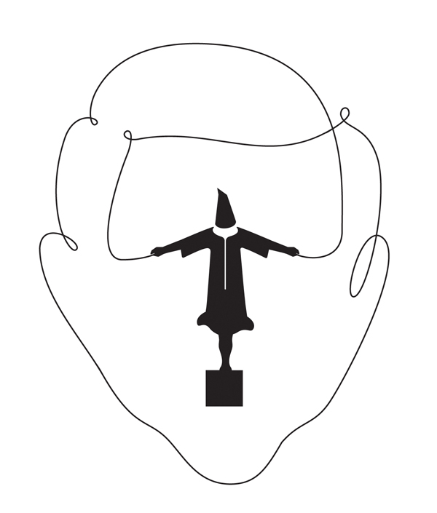

Slide 11
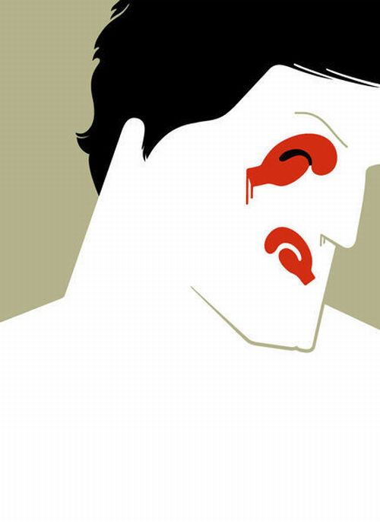

Slide 24
Luciano Pavarotti

