Slide 1
What we will review:
Don’t be Intimidated
Learning Code is easier than it looks if you give it some effort
Learning web design and development makes you more employable
How Websites are different from Print
You have to plan for the unexpected
How People Access the Web:
Browsers
Web Servers
Devices
Screen Readers
How Websites are Created:
HTML & CSS and W3C standard
Structure
How Website structure relates to print
Examples
Get inspired

Slide 2
Get past your road block of looking at this…
<!DOCTYPE html> <html> <head> <title>Title of the document</title> </head> <body> The content of the document...... </body> </html>
and thinking WTF!!!!!
Code uses real words (although some are acronyms and abbreviations to make life easier) and basic concepts. It is logical.

Slide 3
Freedom of Print Design - http://www.1stwebdesigner.com/design/print-and-web-design/ (reference)
File Size
File isn’t limited by your project, it is only limited by how much storage you have, how fast your computer is, and how slow you want your final file to print. But your final printed product is not affected by a large file size, if anything in print a larger file size is preferable for optimum print quality.
Bigger Canvas = Bigger Design
You will almost always be able to see a huge design in one viewing rather than having to scroll and slide around websites.
One-Size Design
When you design for a standard business card, that design is only going to appear on that size. When you design for a standard folder, that design will only be on that folder. There is no need to really try to make sure everything in a design is in such a way that it can be printed in different sizes. There are a few exceptions, but most of the time the design you create will only be viewed on the paper size it was created for.
Paper or Printed Factor
Sometimes when you design for print you have to design with the entire finished product in mind. For example printing with a letterpress is an added element to your already magnificent design. Printing on matte paper is another technique that can take your design to another level, as well as using a die-cut. These are tactile factors, because people can touch and feel your design. The sense of touch is often part of their interaction.
Physical
Printed graphic design projects are physical and often when creating them we refer to physical mockups. Once printed they do not change based on viewing conditions, someone’s hardware, etc. The print stays the same for each viewer’s experience. Also print is not device dependent.
Limitations of Print Design
Color Selection
You must define your colorspace and calibrate your monitor to get accurate prints
Measurement Limitations
Bleed, Gutter, Safe Area, Project requirements like book spine, common page sizes, etc.

Slide 4
Limitations of Web Design
One-Size DOESN’T Fit All
When you are creating for the web you aren’t just creating for your monitor’s size, but you must create something that will look good in every monitor size, and presently, you have to even keep in mind the small sizes of tablets and mobile devices. Once this is understood it isn’t a huge deal, but starting out this is one of biggest things newbies skip; optimizing designs for all monitor sizes.
Loading Sizes
Another opposite of print design, you almost always have to optimize your designs for the web. File sizes are to be as small as possible so that can load for your audience as quickly as possible. The trick here is lowering your file size and keeping the quality of your pictures.
Support
Not all browsers support all web techniques. Mobile devices don’t use Flash. Some browsers don’t fully support HTML5 and CSS3, the new web standards. Not all viewer’s computers and internet speeds are the same. You have to plan your design so it still works well, even if your motion, video, or new CSS3 style aren’t supported. You have to design to have a backup design should your bells and whistles not work.
Accessibility
Screen Readers are important to those with visual impairments or other disabilities. A screen reader is a program that reads your webpage to the viewer. Legislation focusing on making public buildings accessible to those with disabilities is a practical and mainstream idea. Websites are no different and there is a rise in legislation for it. There are easy ways to make your site accessible to those requiring a screen reader. Not using Flash to design your website structure or images for your type are two great ways to start.
Navigation
Having to interact with on screen media requires more thought on about navigation and organization. Since onscreen is a mainly click and scroll format navigation and organization choices must be carefully considered. Whereas with print viewer’s don’t often question or get confused by navigation, they simply flip pages, unfold brochures, etc. They immediately understand how to interact with the printed media.
Freedom of Web Design - http://www.1stwebdesigner.com/design/print-and-web-design/ (reference)
Infinite Color Selection
The color difference between your mock up and your finished product is almost always the same. The aren’t a ton of limitations on color (not as much as in print) and you can do a bunch more with your colors. The only issue here is hoping other monitors have similar settings to yours in order to translate the design correctly. Also screen contrast issues, but since you are designing on a screen and the design will be seen on a screen you have an advantage over print.
Motion
On the web you have more possibilities to add motion to your designs easily and effectively
Interaction
While the interaction isn’t as physical, other than clicking on or touching the screen, people engage with the web and on screen media much differently than they do with print. You have more options to surprise your viewer.

Slide 5
Other Great info about the differences between web and print design:
http://www.nngroup.com/articles/differences-between-print-design-and-web-design/
http://www.onextrapixel.com/2012/03/01/the-difference-between-print-and-web-design/
Great article about Transitioning from Print to Web:
**Note although with Google Web Fonts now we are not as limited as we once were
http://www.thedesigncubicle.com/2009/03/transitioning-from-a-print-to-web-designer/

Slide 6
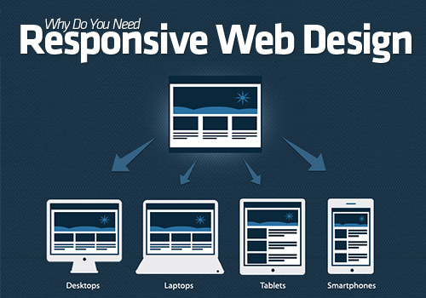
The whole graphic can be seen here
http://cdn.dotcominfoway.com/images/responsive-web-design-infographic.jpg
Great RESPONSIVE explanation and example:
trentwalton.com
Responsive examples collection
http://sixrevisions.com/design-showcase-inspiration/responsive-webdesign-examples/

Slide 7
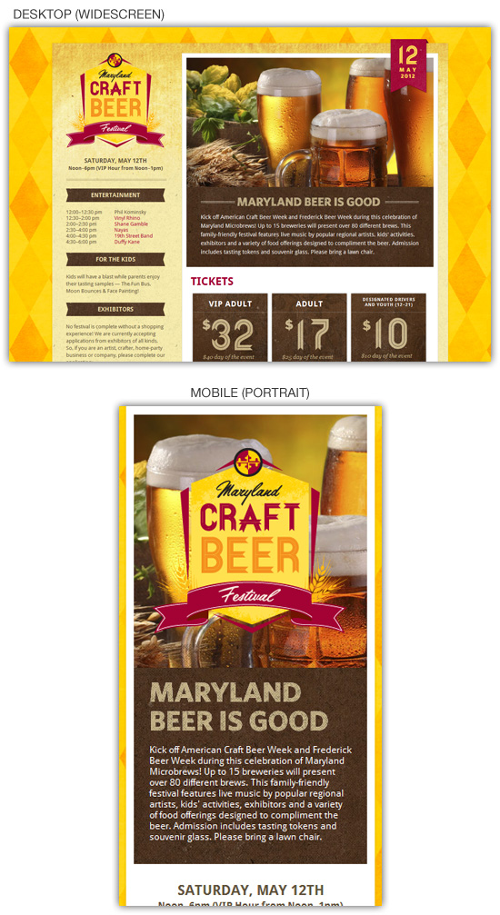
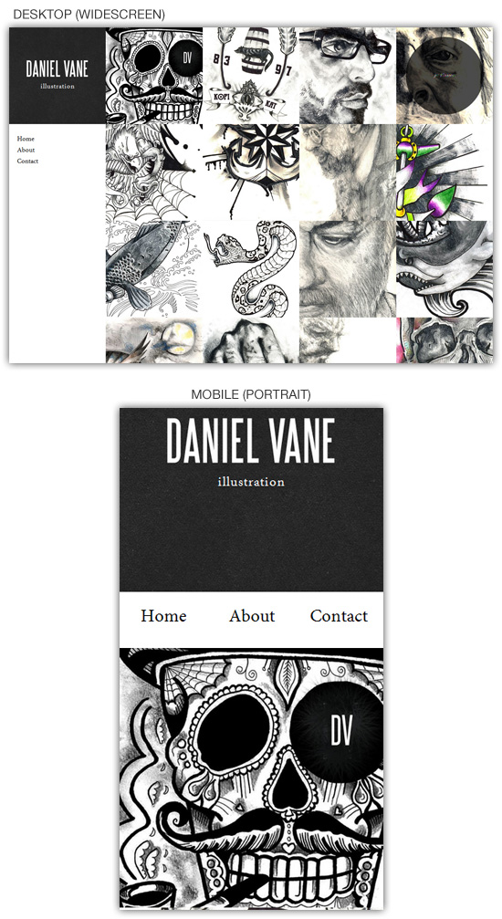
http://danielvane.com/
http://mdcraftbeerfestival.com/

Slide 8
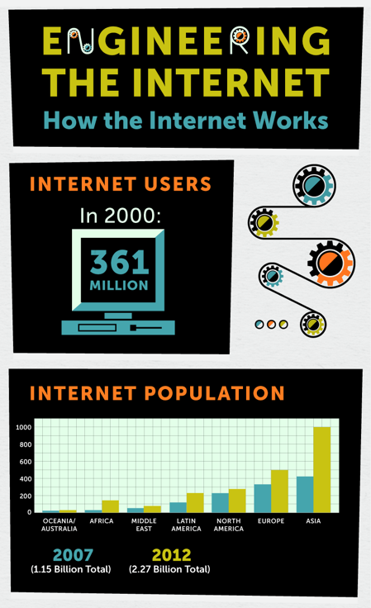
How The Internet Works
& How People Access the Web
See this great motion inforgraphic
http://inspirationfeed.com/inspiration/infographics/how-the-internet-works-infographic-2/

Slide 9
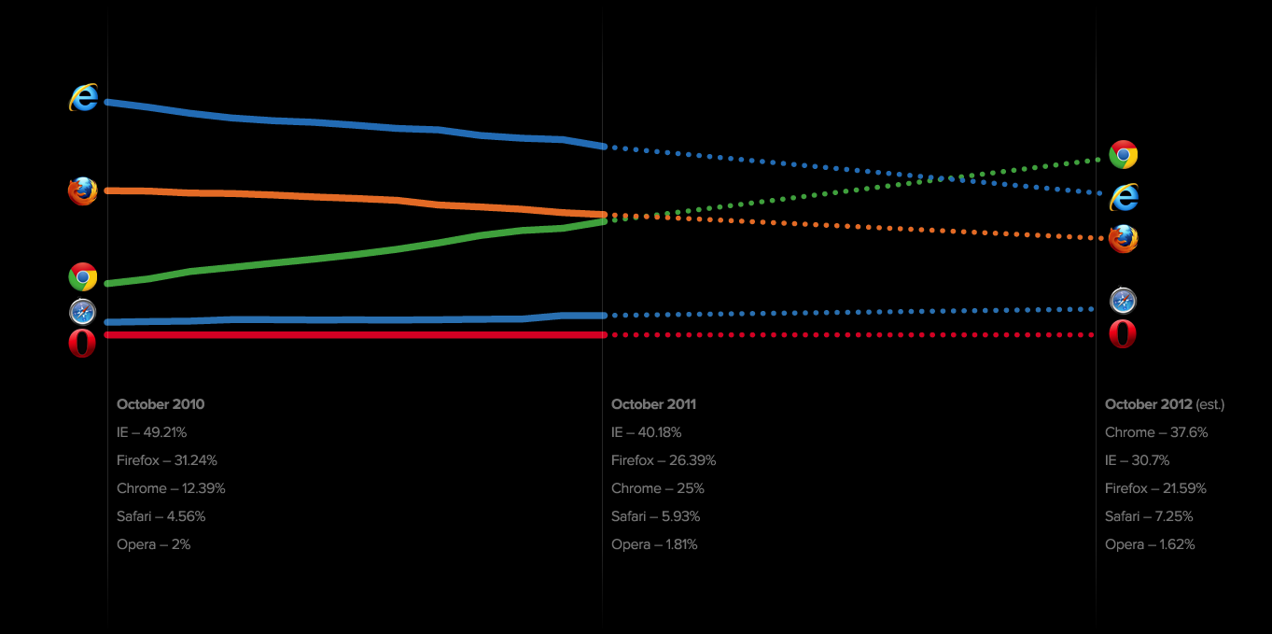
Browser Popularity

Slide 10
How Webpages Are Created
HTML- Hyper Text Markup Language
All websites use HTML
HTML creates the structure of the page by using tags that describe content
CSS- Cascading Style Sheets
Almost all websites use CSS
CSS defines how to style HTML elements, it is the icing on the cake
Quick demo: http://www.w3schools.com/css/demo_default.htm
JavaScript and jQuery
Advanced topics to explore after you are comfortable with HTML and CSS
JavaScript is THE Scripting language of the web, the most popular programming language, it changes the way a page behaves and produces enhanced user interfaces and dynamic websites with interaction
jQuery is a JavaScript library “write less, do more”, a lightweight way to add JavaScript on your website, often in the form of a single line of code called a plugin
PHP, ASP.Net, Java and Ruby
These are examples of programming languages used for larger websites, most designers team up with developers to create and code complex websites like CMS (content management systems like Weebly, Wix, Square Space, Wordpress.org), blogging sites (Wordpress.com, Blogger, Tumblr), e-commerce (Amazon)
Evolution of Web Design
http://blog.kissmetrics.com/wp-content/uploads/2011/04/Evolution-of-web-design.png

Slide 11
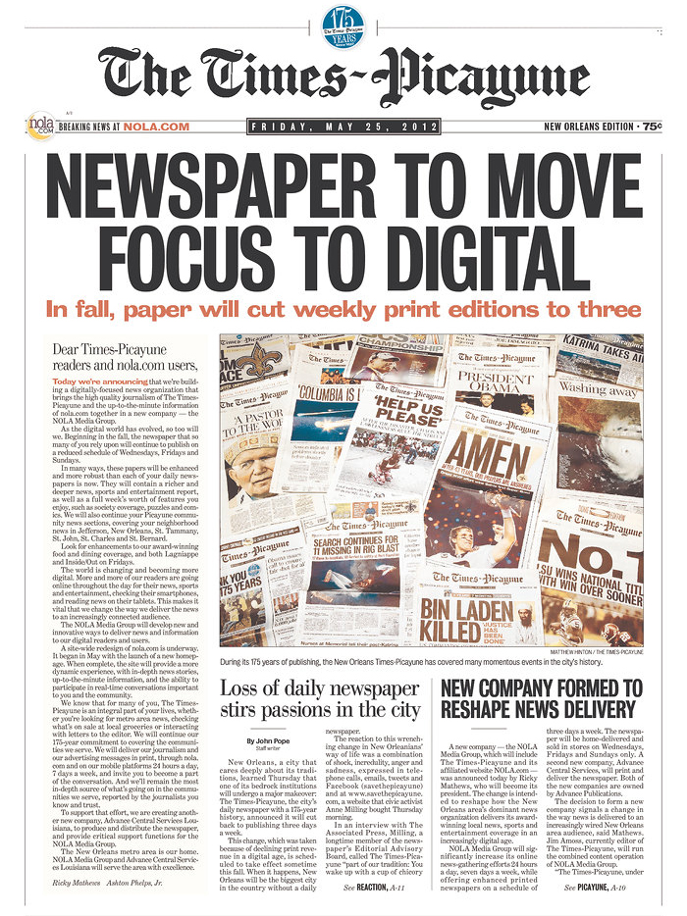
Page Structure
If you think of a newspaper, book, or even a business card, there is a hierarchy to the information that helps us understand and interpret what we are reading.
Lets look at the bones:
Imagine the Newspaper had no content yet,
we just looked at its structure
Headlines
Subheadings
Body copy
Sections

Slide 12
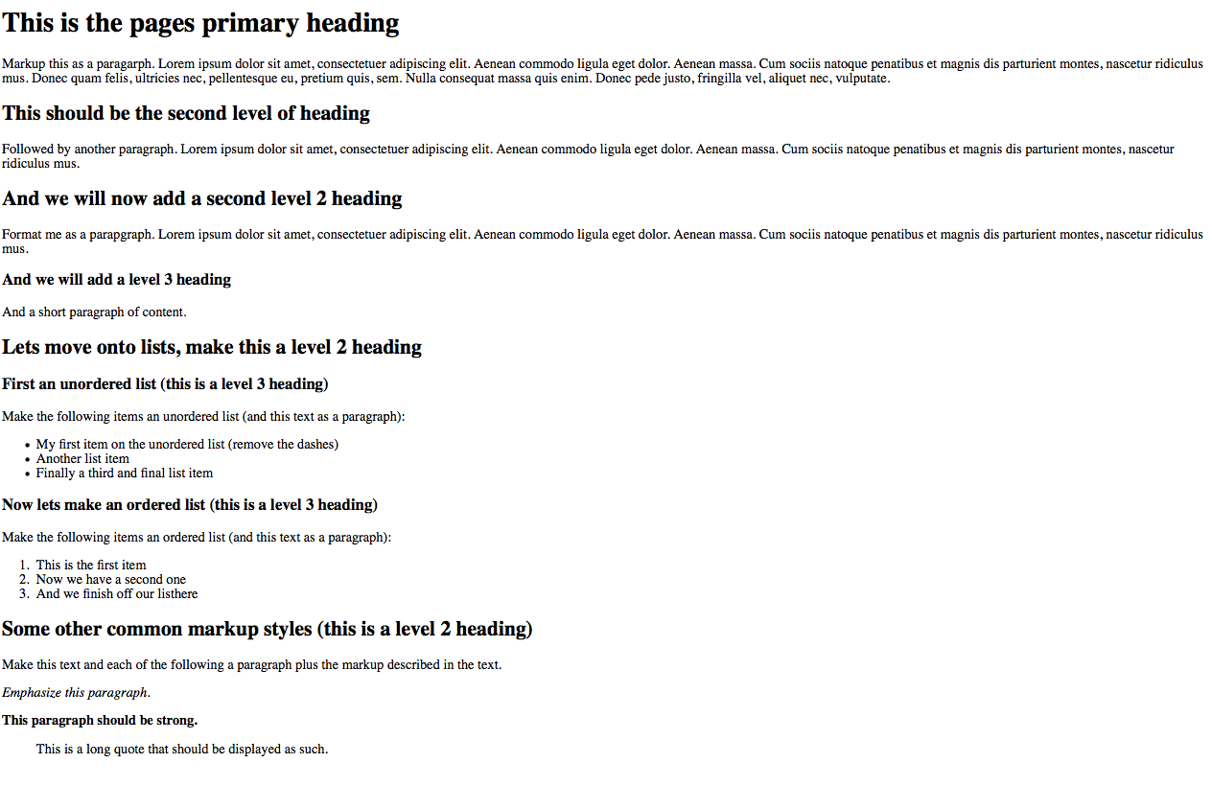

Slide 13
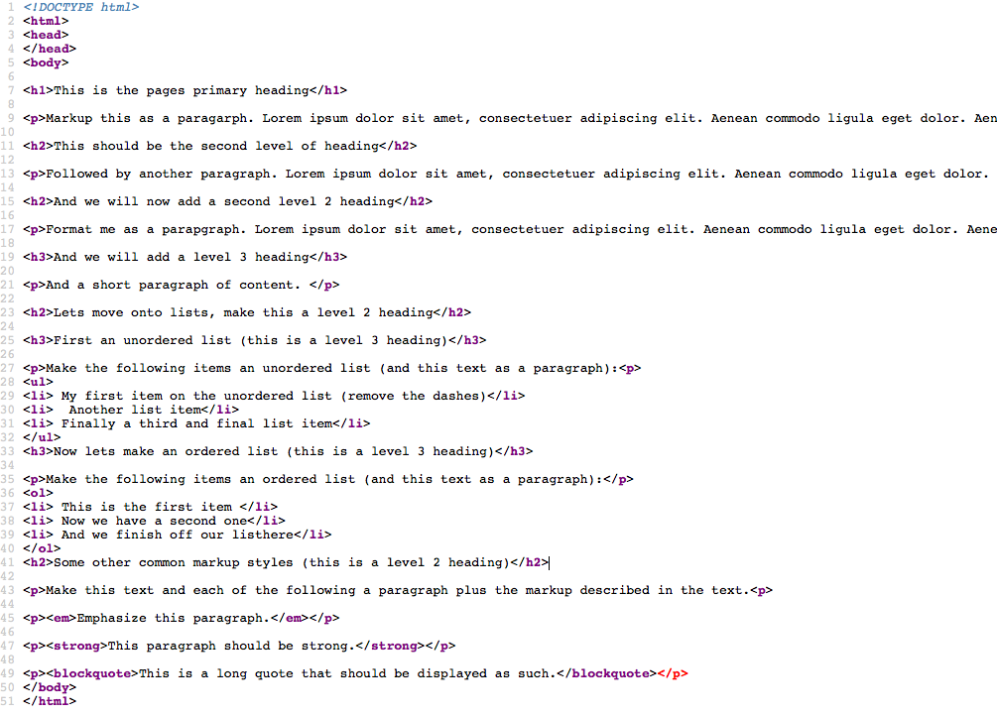
DOCTYPE: Instruction to Web Browser telling it what version of HTML the page was written in. This is HTML5’s simplified <!DOCTYPE html>
<html> indicates that anything between it and closing tag </html> is html code
<head> area to add a page title that shows in browser title area, internal stylesheets, metadata like keywords, author, links to external stylesheets and scripts such as JavaScript
<body> indicates that anything between it and closing tag </body> is the content of the page

Slide 14
AJAX uses
AJAX is action not content
AJAX = Asynchronous JavaScript & XML
CSS and the div (divisions) take over tables to form a site’s structure

Slide 15
HTML = Hyper Text Markup Language
HTML5= latest HTML version, in 2006 W3C (World Wide Web Consortium) and WHATWG (Web Hypertext Application Technology Working Group) decided to cooperate and create a new version of HTML
New Elements
New Attributes
Full CSS3 Support
Video and Audio
2D/3D Graphics
Local Storage
Local SQL Database
Web Applications
HTML5 - New Features
Some of the most interesting new features in HTML5:
The <canvas> element for 2D drawing
The <video> and <audio> elements for media playback
Support for local storage
New content-specific elements, like <article>, <footer>, <header>, <nav>, <section>
New form controls, like calendar, date, time, email, url, search
Steve Jobs famously refuses to allow Flash on the iOS due to the many bugs and crashes it experiences, therefore, learning how to use the more intricate features of HTML5 is going to be a must for those who want to develop apps and iOS-friendly websites. With Google rolling out an HTML5-friendly version of YouTube, many developers are starting to see how important this system will become in the near future. However, some features are not supported on all browsers or devices yet, developers and designers are still feeling the need to cover all of their bases when implementing new features on a website.

Slide 16
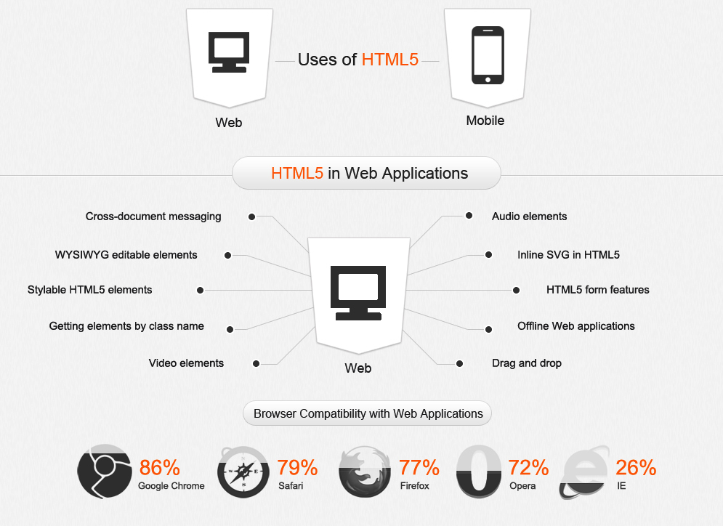
http://html5readiness.com/

Slide 17
XHTML = Strict and cleaner version of HTML, the main difference between XHTML and HTML4 is that all tags, once opened, must be closed. This is good coding practice. HTML5 is a bit less strict and as you saw opens many more possibilities, but closing tags is ALWAYS GOOD PRACTICE!
XHTML = EXtensible HyperText Markup Language
XHTML is almost identical to HTML 4.01
XHTML is a stricter and cleaner version of HTML 4.01
XHTML is HTML defined as an XML application
XHTML is supported by all major browsers.

Slide 18
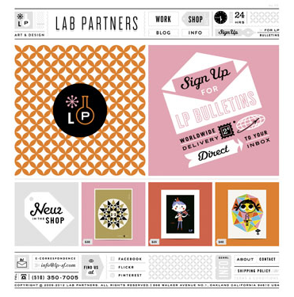
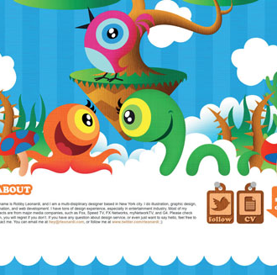
CSS3, great new properties:
http://net.onextrapixel.com/wp-content/uploads/2011/09/css3-infographic-full.jpg
CSS3 is fun! Check out the power of CSS
http://www.csszengarden.com/
http://lp-sf.com/
http://rleonardi.com/

Slide 19
JavaScript
JavaScript is the world's most popular programming language. It is the language for HTML and the web, for servers, PCs, laptops, tablets, smart phones, and more.
JavaScript is a Scripting Language
A scripting language is a lightweight programming language.
JavaScript is programming code that can be inserted into HTML pages.
JavaScript inserted into HTML pages, can be executed by all modern web browsers.
JavaScript is easy to learn.

Slide 20
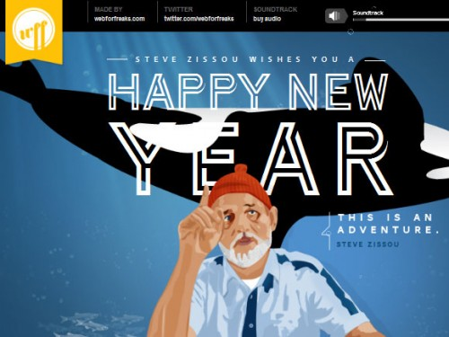
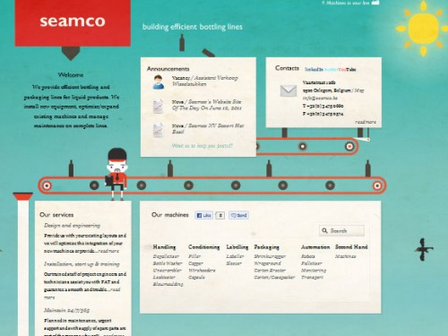
Inspiration
typographyserved.com
brandingserved.com
adccreativecrush.org
ww.editorialdesignserved.co
illustrationserved.com
mashingmagazine.com
www.thefwa.com
Parallax Scroll
artofflightmovie.com
http://www.nike.com/jumpman23/aj2012/
Cool Sites
http://robedwards.org/
http://webforfreaks.com/2011/
http://www.seamco.be/home

Slide 21
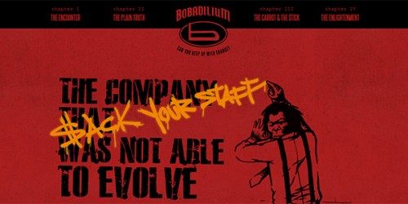
http://glamour.biz/
http://bobadilium.com/

